Slide 1

Avinash Bhavancheekar (QA Manager) Rushab Ramesh Vaza(QA ANALYST) Jensikumari Jesoliya(QA ANALYST) Ruthwik Mamidala (Software Tester) Shivani Nallu (Software Tester) Shivaly (Software Tester) Darshna(BUSINESS ANALYST) Sumedh(BUSINESS ANALYST) Aasritha (Software Tester)
CS631G – CRN 74069 – SOFTWARE VERIFICATION – TEAM 3

Slide 2
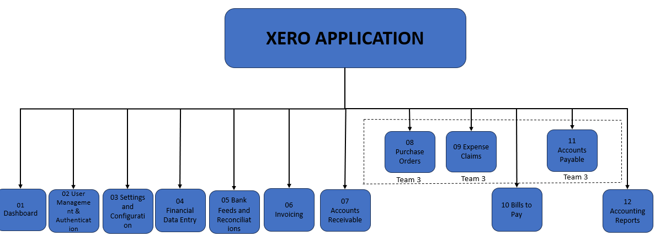
Functional Decomposition Diagram
(jensikumari ishvarbhai

Slide 3
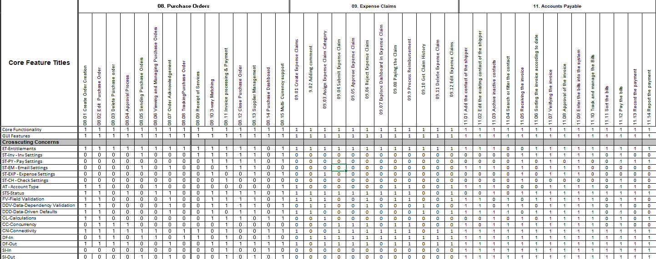
RCT
(Aasritha Bhimisetty)

Slide 4
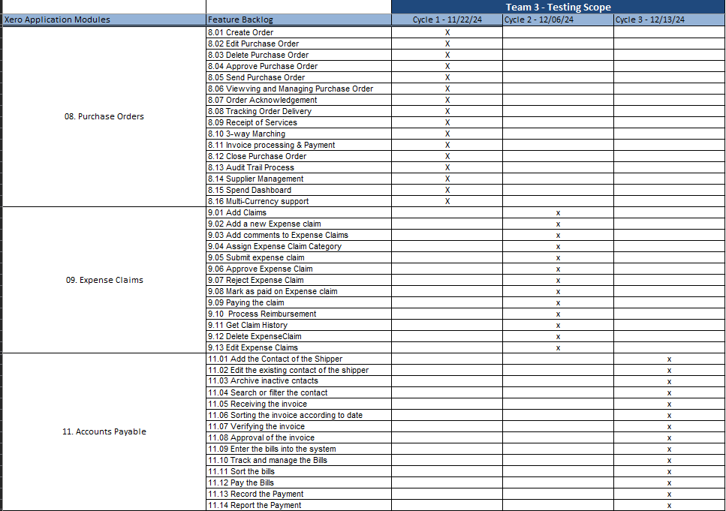
Testing Roadmap
(Avinash Bhavancheekar)

Slide 5
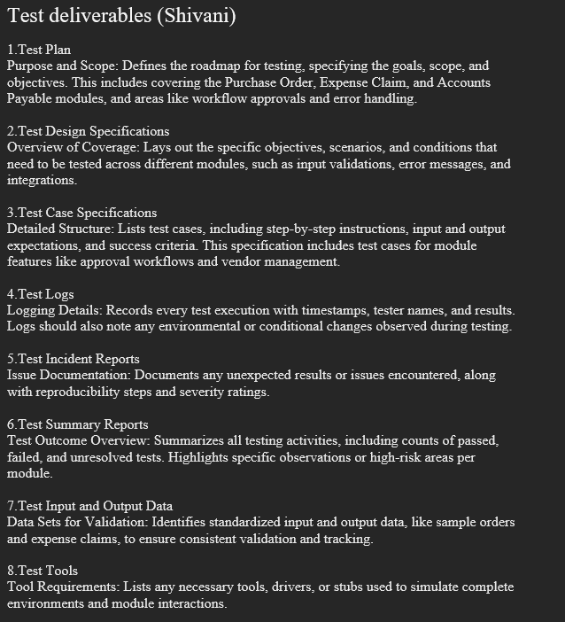
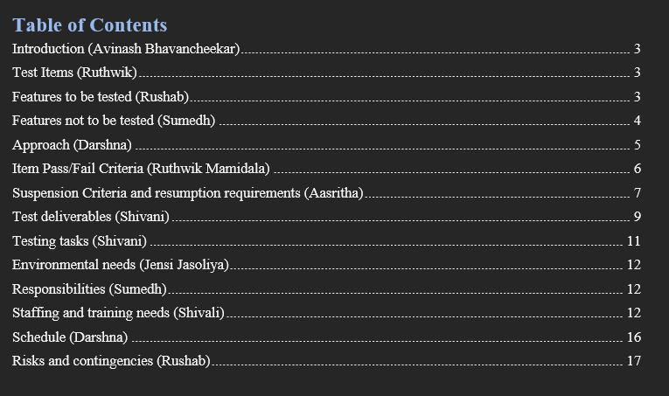
Test Plan
(Shivani Nallu)

Slide 6
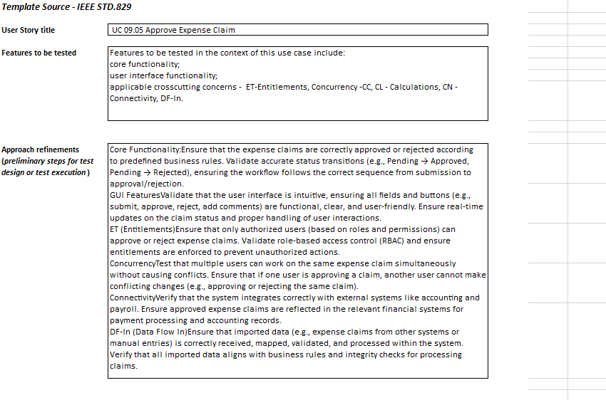
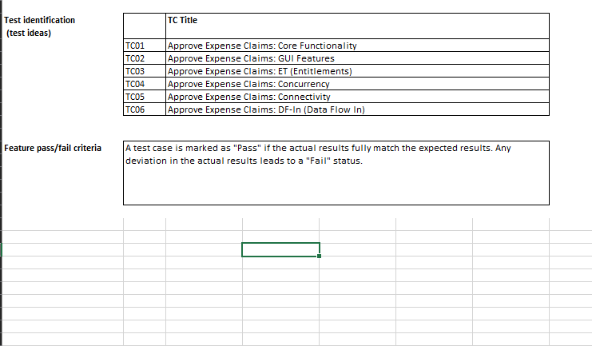
Test Desing Specification
(Darshna)

Slide 7
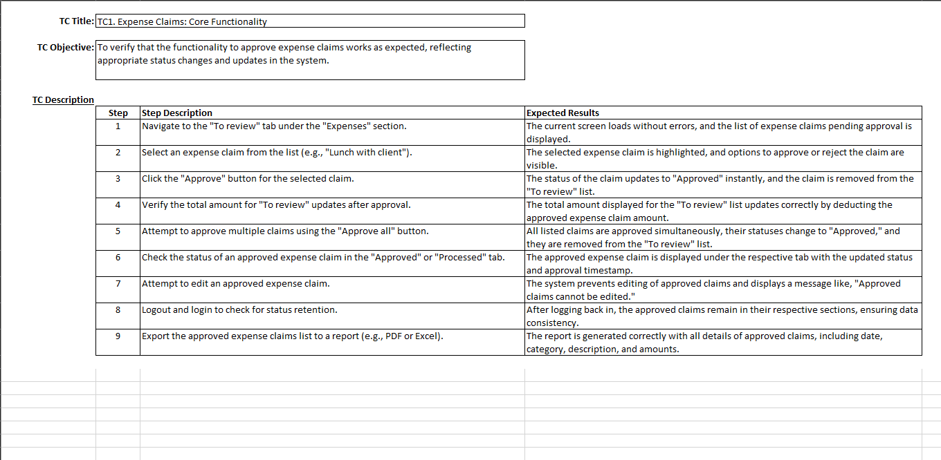
Test Case Specification
(Shivaly)

Slide 8
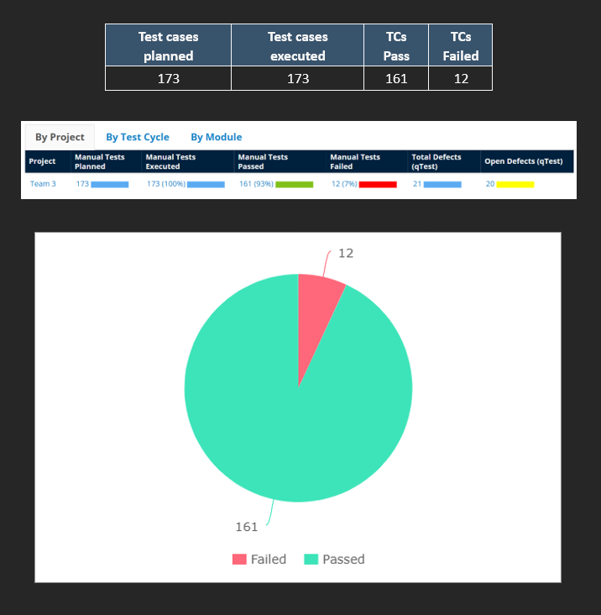
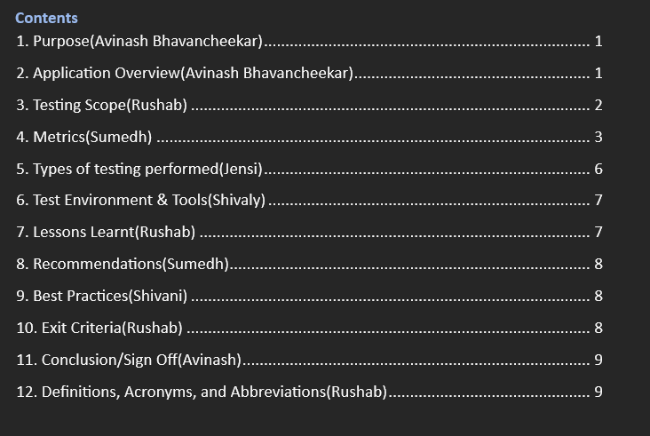
Test Summary Report
(Rushab Ramesh Vaza)

Slide 9
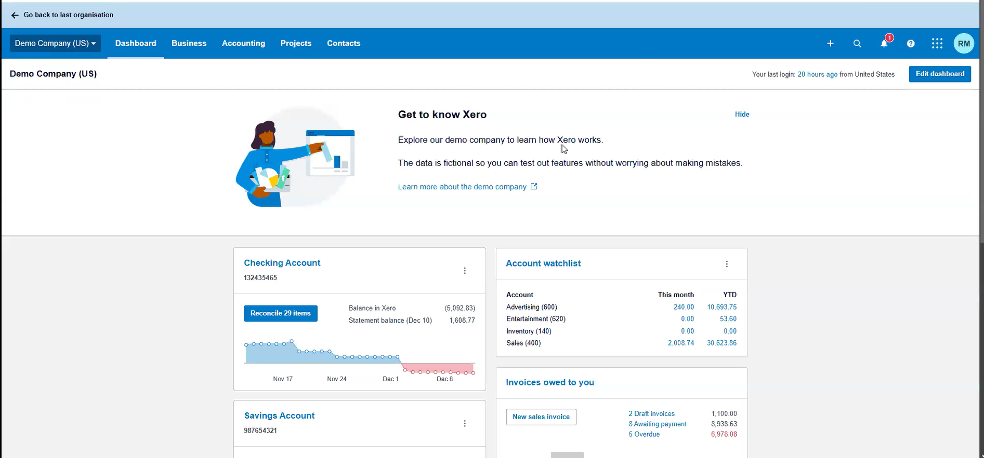
Application Demo
(Ruthwik)

Slide 10
Appendix:
GitHub Repository

Slide 11

GitHub Repo Link
🔗 https://github.com/CS631G-Team-3/CS631G-Software-Verification-Team-3

Slide 12

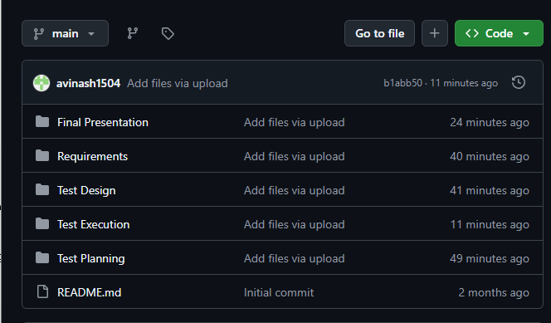

GitHub Repo Folder Structure
Requirements
Test Planning
Test Design
Test Execution
Final Presentation

Slide 13
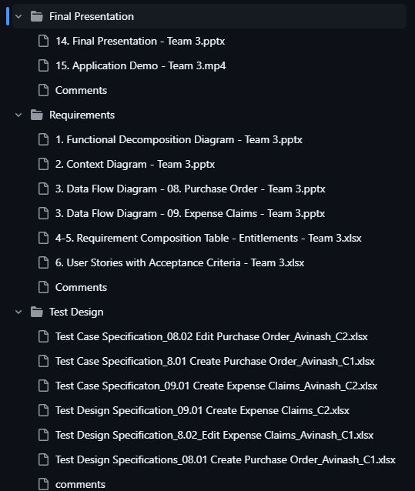
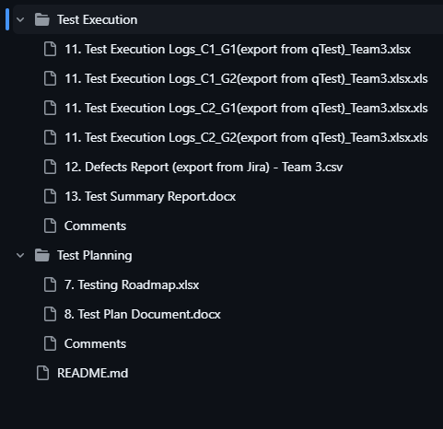
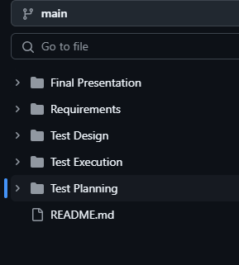
GitHub Repo Folder Structure

Slide 14
THANK YOU

